Slide 1
Chapter 19: The Pentium II, Pentium III, Pentium, 4, and Core2 Microprocessors

Slide 2
Introduction
The Pentium II, III, 4, and Core2 processors may well signal the end to the evolution of
the 32-bit architecture with the advent of
the Itanium.

Slide 3
Chapter Objectives
Upon completion of this chapter, you will be able to:
Detail the differences between the Pentium II, Pentium III, Pentium 4, and Core2 and prior Intel microprocessors.
Explain how the basic architecture of the computer system has changed, and speed improved by using the Pentium II, Pentium III, Pentium 4, and Core2 microprocessors.

Slide 4
Chapter Objectives
(cont.)
Upon completion of this chapter, you will be able to:
Detail the changes to the CPUID instruction and model-specific registers.
Describe the operation of the SYSENTER
and SYSEXIT instructions.
Describe the operation of the FXSAVE and FXRSTOR instructions.

Slide 5
19–1 INTRODUCTION TO THE PENTIUM II MICROPROCESSOR
This section details operation of each pin, with external memory system and I/O structures.
Fig19–1 shows the Pentium II processor slot 1 connector & interface signals to the chip set.
Fig 19–2 shows a simplified diagram of the components on the cartridge, placement of Pentium II cartridge and bus components in
a typical Pentium II system.

Slide 6
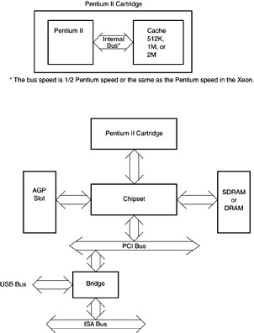
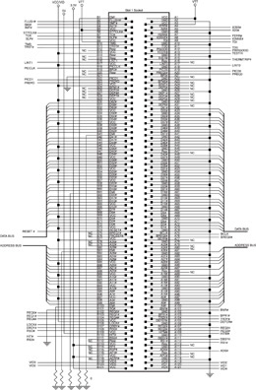
Figure 19–1 The pin-out of the slot 1 connector showing the connections to the system.
Figure 19–2 The structure of the Pentium II cartridge and the structure of the Pentium II system.

Slide 7
There are 242 pins on the slot 1 connector.
  a reduction in the number of pins found on Pentium and Pentium II microprocessors
Pentium II is packaged on a printed circuit board instead of IC chips of past processors.
Level 1 cache is 32K bytes.
Level 2 cache is no longer inside the IC. Intel changed architecture so a level 2 cache could be placed very close to the microprocessor.
  this makes the processor less expensive and
  still allows the L2 cache to operate efficiently

Slide 8
Pentium level 2 cache operates at one half the microprocessor clock frequency.
  a 400 MHz Pentium II has 200 MHz cache speed
Pentium II is available in three versions.
  first is the full-blown Pentium II, for the slot 1 connector
  Celeron with a slot 1 circuit board that does not contain a level 2 cache; L2 is on the main board and operates at 66 MHz
  Xeon with L2 cache of 512K, 1M, or 2M which operates at clock frequency of the processor; a 400 MHz Xeon has an L2 speed of 400 MHz

Slide 9
Early versions of Pentium II require a 5.0 V, 3.3 V, and variable voltage for operation.
  main variable power supply voltages vary from 3.5 V to as low as 1.8 V at the microprocessor
Known as Core microprocessor voltage.
Power-supply current averages 14.2 A to 8.4 A, depending on the operating frequency and voltage of Pentium II.
Heat sink & fan are built into the PII cartridge.
  latest versions of Pentium II have been
  improved to reduce the power dissipation

Slide 10
Each Pentium II cartridge output pin is capable of at least 36 mA of current at logic 0.
  some output control signals provide only
  14 mA current
Outputs are open-drain and require an external pull-up resister for proper operation.

Slide 11
Pentium II Pin-Outs
A20
Address A₂₀ mask is an input asserted in real mode to signal Pentium II to perform address wraparound, as in the 8086 microprocessor, for use of the HIMEM.SYS driver.

Slide 12
A35-A3
Pentium II Pin-Outs
Address buses, which are active low connections, address any of the memory locations found in Pentium II memory system.
A₀, A₁, & A₂ encoded in bus enable BE7-BE0 which are generated by the chip set, to select any or all of the eight bytes in a 64-bit-wide memory location.

Slide 13
ADS
Pentium II Pin-Outs
Address data strobe is an input that is activated to indicate to Pentium II that the system is ready to perform a memory or
I/O operation.
This signal causes the microprocessor to provide the address to the system.

Slide 14
AERR
Pentium II Pin-Outs
Address error is an input used to cause Pentium II to check for an address parity
error if it is activated.
AP1, AP0
Address parity inputs indicate an address parity error.

Slide 15
BCLK
Pentium II Pin-Outs
Bus clock is an input that sets the bus clock frequency. This is either 66 MHz or 100 MHz in Pentium II.
BERR
Bus error is asserted to indicate that an error has occurred on the bus system.

Slide 16
BINIT
Pentium II Pin-Outs
Bus initialization is a logic 0 during system reset or initialization. It is an input to indicate that a bus error has occurred and the system needs to be reinitialized..
BNR
Bus not ready is used to insert wait states in the timing for Pentium II. Placing logic 0 on this pin causes PII to enter stall or wait states.

Slide 17
BP3, BP2, PM1/BP1 and PM0/BP0
Pentium II Pin-Outs
Bus initialization is a logic 0 during system reset or initialization. It is an input to indicate
a bus error has occurred and the system needs to be reinitialized.
BPRI
The bus priority request input is used to request the system bus from Pentium II.

Slide 18
BR1 and BR0
Pentium II Pin-Outs
Bus requests indicate that Pentium II has generated a bus request. During initialization, the BR0 pin must be activated.
BSEL
Bus select is currently not used by Pentium II and must be connected to ground for proper operation.

Slide 19
D63 - D0
Pentium II Pin-Outs
Data bus connections transfer byte, word, doubleword, and quadword data between processor and memory & I/O system.
DEFER
The defer signal indicates that the external system cannot complete the bus cycle.

Slide 20
EP7 - EP0
Pentium II Pin-Outs
Data EEC pins are used in the error-correction scheme of Pentium II and normally connect to an extra 8-bit memory section. This means that ECC memory modules are 72 bits wide instead of 64 bits wide.
DRDY
Data ready is activated to indicate that the system is presenting valid data to Pentium II.

Slide 21
EMI
Pentium II Pin-Outs
Electromagnetic interference must be grounded to prevent Pentium II from generating or receiving noise.
FERR
Floating-point error, comparable to the ERROR line in the 80386, shows that the internal coprocessor has erred.

Slide 22
FLUSH
Pentium II Pin-Outs
The flush cache input causes cache to flush all write-back lines and invalidate its internal caches. If FLUSH input is logic 0 during a
reset operation, Pentium enters its test mode.
FRCERR
Functional redundancy check is sampled during a reset to configure Pentium II in the master (1) or checker (0) mode.

Slide 23
HIT
Pentium II Pin-Outs
Hit shows that the internal cache contains valid data in the inquire mode.
HITM
Hit modified shows that the inquire cycle found a modified cache line. This output is used to inhibit other master units from accessing data until the cache line is
written to memory.

Slide 24
IERR
Pentium II Pin-Outs
The internal error output shows that Pentium II has detected an internal error or functional redundancy error.
IGNNE
The ignore numeric error input causes Pentium II to ignore a numeric coprocessor error.

Slide 25
INIT
Pentium II Pin-Outs
The initialization input performs a reset without initializing the caches, write-back buffers, and floating-point registers.
This input may not be used to reset the microprocessor in lieu of RESET after
power-up.

Slide 26
INTR
Pentium II Pin-Outs
Interrupt request is used by external circuitry to request an interrupt.

Slide 27
LINT₁, LINT₀
Pentium II Pin-Outs
Local APIC interrupt signals must connect appropriate pins of all APIC bus agents.
When APIC is disabled, LINT₀ signal
becomes INTR, a maskable interrupt
request signal
LINT₁ becomes NMI, a non-maskable interrupt.

Slide 28
LOCK
Pentium II Pin-Outs
Becomes a logic 0 whenever an instruction is prefixed with the LOCK: prefix. Most often used during DMA accesses.
NMI
Non-maskable interrupt requests a non maskable interrupt as it did on the earlier versions of the microprocessor.

Slide 29
PICCLK
Pentium II Pin-Outs
This clock signal must be1/4 the frequency
of BCLK.
PICD₁, PICD₀
Used for serial messages between Pentium II and APIC.

Slide 30
PRDY
Pentium II Pin-Outs
The probe ready output indicates that the probe mode has been entered for debugging.
PREQ
Probe request is used to request debugging.
PWRGOOD
The power good input that indicates the system power supply is operational.

Slide 31
REQ4 - REQ0
Pentium II Pin-Outs
Request signals communicate commands between bus controllers and Pentium II.

Slide 32
RESET
Pentium II Pin-Outs
Reset initializes PII, causing it to execute software at FFFFFFF0H or 000FFFF0H.
Bits A₃₅–A₃₂ are set as logic 0s during reset.
Pentium II is reset to real mode and leftmost 12 address connections remain logic 1s (FFFH) until a far jump/far call is executed.
See Table 19–1 for the state of Pentium II after a hardware reset.

Slide 33
RP
Pentium II Pin-Outs
Request parity is used to request parity.
RS2-RS0
Request status inputs are used to request
the current status of Pentium II.
RSP
The response parity input is activated to request parity.

Slide 34
SLOTOCC
Pentium II Pin-Outs
The slot occupied output is a logic 0 if slot zero contains either a Pentium II or a dummy terminator.
SLP
Sleep is an input that, when inserted in the stop-grant state, causes Pentium II to enter the sleep state.

Slide 35
SMI
Pentium II Pin-Outs
The system management interrupt input causes Pentium II to enter the system management mode of operation.
STPCLK
The stop clock input causes Pentium II to enter the low-power stop-grant state.

Slide 36
TCK
Pentium II Pin-Outs
The testability clock input selects the clocking function in accordance with the
IEEE 1149.1 Boundary Scan interface.
TDI
The test data input is used to test data clocked into Pentium II with the TCK signal

Slide 37
TDO
Pentium II Pin-Outs
The test data output is used to gather test data and instruction shifted out of Pentium II with TCK.
TESTHI
Test high is an input that must be connected to +2.5 V through a 1K–10K ohm resister for proper Pentium II operation

Slide 38
THERMTRIP
Pentium II Pin-Outs
Thermal sensor trip is an output that becomes a zero when the temperature of Pentium II exceeds 130°C.
TMS
The test mode select input controls the operation of Pentium in test mode.

Slide 39
TRDY
Pentium II Pin-Outs
Target ready is an input that is used to cause Pentium II to perform a write-back operation.
VID4-VID0
Voltage data output pins are either open or grounded signals that indicate what supply voltage is currently required by Pentium II.
The power supply must apply the request voltage to Pentium II, as listed in Table 19–2.

Slide 40
The Memory System
64G bytes in size, like Pentium Pro.
  64 bits wide with a 36-bit-wide address bus
Most systems use SDRAM operating at 66 MHz or 100 MHz for Pentium II.
The SDRAM for the 66 MHz system has an access time of 10 ns.
SDRAM for the 100 MHz system has an access time of 8 ns.

Slide 41
PII memory system is divided into eight or nine banks that each store a byte of data.
  ninth byte stores error-checking code (ECC)
PII employs internal parity generation and checking logic for the memory system’s data bus information.
  if parity checks are employed, each memory
  bank contains a ninth bit
Figure 19–3 shows the memory map of Pentium II system, using AGP for video.

Slide 42
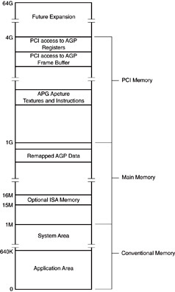
Figure 19–3 The memory map of a Pentium II–based computer system.
  an area of memory is used for the AGP area, to allow the video card and Windows to access the video information
  in a linear address space
  benefit is much faster video updates because the video card does not need to page through the 128K-byte DOS video memory

Slide 43
Transfers between Pentium II and the memory system are controlled by the
440 LX or 440 BX chip set.
  data transfers are eight bytes wide
The chip set communicates to the processor through the five REQ signals
In essence, the chip set controls Pentium II.
  a departure from the traditional method of connecting a processor directly to the memory
Pentium II connects only directly to the cache, which is on Pentium II cartridge.

Slide 44
Input/Output System
Compatible with earlier Intel microprocessors.
The I/O port number appears on address lines A₁₅–A₃ with bank-enable signals used to select actual memory banks used for the I/O transfer.
  transfers are controlled by the chip set
I/O privilege information is added to the TSS segment when PII is in protected mode.
If the blocked I/O is accessed, PII generates
a type 13 interrupt, an I/O privilege violation.

Slide 45
System Timing
Because Pentium II is designed to be controlled by the chip set, the timing
signals between the microprocessor and
the chip set have become proprietary to Intel.

Slide 46
19–2 PENTIUM II SOFTWARE CHANGES
Pentium II microprocessor core is a Pentium Pro.
  this means Pentium II and Pentium Pro are essentially the same device for software
This section lists the changes to the CPUID instruction and the SYSENTER, SYSEXIT, FXSAVE, and FXRSTORE instructions
  the only modifications to the software

Slide 47
CPUID Instruction
Table 19–4 lists the values passed between Pentium II and the CPUID instruction.
Version information returned after executing CPUID with logic 0 in EAX is returned in EAX.
  family ID is returned in bits 8 to 11
  model ID is returned in bits 4 to 7
  stepping ID is returned in bits 0 to 3
Pentium II model number is 6; family ID is a 3.
Stepping number refers to an update number.
  the higher the number, the newer the version

Slide 48
Features are indicated in EDX register after executing CPUID instruction with 0 in EAX.
  two new features are returned in EDX for PII
Bit position 11 indicates support for the two new fast call instructions.
  SYSENTER and SYSEXIT
Bit position 23 indicates MMX support.
The remaining bits are identical to earlier versions of the processor
Bit 16 indicates whether the microprocessor supports the page attribute table or PAT.

Slide 49
Bit 17 indicates whether the processor supports the page size extension found with Pentium Pro and Pentium II processors.
  page size extension allows memory above 4G through 64G to be addressed
Bit 24 indicates whether fast floating-point save (FXSAVE) and restore (FXRSTOR) instructions are implemented.

Slide 50
SYSENTER and SYSEXIT Instructions
SYSENTER and SYSEXIT instructions use the fast call facility introduced in Pentium II.
These instructions function only in ring 0 (privilege level 0) in protected mode.
  Windows operates in ring 0, but does not allow applications access to ring 0
These new instructions are meant for OS software because they will not function at
any other privilege level.

Slide 51
SYSENTER instruction uses some model-specific registers to store CS, EIP, and ESP to execute a fast call to a procedure defined by the model-specific register.
  it does not push return address onto the stack
  as does a regular call
Table 19–5 shows the model-specific register used with SYSENTER and SYSEXIT.
  model-specific registers are read with the
  RDMSR instruction
  written with the WRMSR instruction.

Slide 52
To use RDMSR or WRMSR place the
register number in the ECX register.
If WRMSR is used, place the new data
for the register in EDS:EAX.
For SYSENTER, you need only the EAX register, but place a 0 in EDX.
If RDMSR is used in a program the data is returned in the EDX:EAX registers.

Slide 53
To use SYSENTER, you must first load the model-specific registers with the address of the system entrance point into registers:
  SYSENTER_CS
  SYSENTER_ESP
  SYSENTER_EIP
This would normally be the entrance address and stack area of the operating system such as Windows 2000 or Windows XP.
This instruction is meant as a system instruction to access code/software in ring 0.

Slide 54
The stack segment register is loaded with the value placed into SYSENTER_CS plus 8.
  the selector pair addressed by SYSENTER_CS selector value is loaded into CS and SS
The value of the stack offset is loaded into SYSENTER_ESP.
The SYSEXIT instruction loads CS and SS with the selector pair addressed by SYSENTER_CS plus 16 and 24.
Table 19–6 shows selectors from the global selector table, addressed by SYSENTER_CS.

Slide 55
SYSEXIT passes the value in EDX to the EIP register and the value in ECX to ESP.
  SYSEXIT returns control to application ring 3
To use SYSENTER and SYSEXIT, the SYSENTER instruction must pass the return address to the system.
The stack segment is transferred by loading the stack segment selector into SYSENTER_CS+24 and the ESP into ECX.

Slide 56
FXSAVE and FXRSTOR Instructions
The last two new instructions are FXSAVE and FXRSTOR.
  almost identical to FSAVE and FRSTOR
FXSAVE stores state of the MMX machine.
  FSAVE stores the state of the coprocessor
FSAVE stores the entire tag field.
  FXSAVE stores only valid bits of the tag field
The valid tag field is used to reconstruct the restore tag field when FXRSTOR executes.

Slide 57
For new applications, it is recommended the FXSAVE and FXRSTOR instructions be used to save the MMX state and floating-point state of the machine.
  do not use FSAVE & FRSTOR in new applications

Slide 58
19–3 Pentium III
Even though it is newer than Pentium II, it is still based on Pentium Pro architecture.
There are two versions of Pentium III.
  one version available with a nonblocking 512K-byte cache, which runs at half the processor
  clock frequency, packaged in the slot 1 cartridge
  the other with a 256K-byte advanced transfer cache, at processor speed, packaged in an IC

Slide 59
Chip Sets
Pentium III chip set is different from PII.
  PIII uses an Intel 810, 815, or 820 chip set
A few other vendors’ chip sets are available, but problems with drivers for new peripherals, such as the video cards, have been reported.
An 840 chip set also was developed for Pentium III, but Intel did not make it available.

Slide 60
Bus
Pentium III Coppermine increases the bus speed to either 100 MHz or 133 MHz.
  the faster version allows transfers between processor and memory at higher speeds
The last released version of Pentium III was
1 GHz with a 133 MHz bus.
  one might think memory bus speed could be faster to improve performance, but connections between processor and memory preclude a higher speed for the memory

Slide 61
Consider a 200 MHz memory bus speed.
  a wavelength at 200 MHz is 300,000,000/200,000,000 or 3/2 meter
An antenna is 1/4 of a wavelength.
  at 200 MHz, an antenna is 14.8 inches
To avoid radiating energy at 200 MHz,
printed circuit board connections must
be shorter than 1/4-wavelength.
  in practice no more than 1/10 of 1/4-wavelength
  connections in a 200 MHz system should be no longer than 1.48 inches

Slide 62
Size presents the board manufacturers with
a problem when placing the sockets for a
200 MHz memory system.
Will it be possible to exceed the 200 MHz memory system?
  if bus is tuned, there may be a way to go higher
  in frequency
  if a new technology for interconnecting processor, chip set, and memory is developed

Slide 63
At present memory functions in bursts of four 64-bit numbers with each main memory read.
  this burst of 32 bytes is read into the cache
Main memory requires three wait states at 100 MHz to access the first 64-bit number.
  zero wait states for each of the three remaining 64-bit wide numbers
  a total of seven 100 MHz bus clocks
Data read is at 70 ns/32 = 2.1875 ns per byte.
  a bus speed of 457M bytes per second

Slide 64
Pin-Out
Figure 19–4 shows the pin-out of the socket 370 version of Pentium III microprocessor.
This integrated circuit is packaged in a 370-pin, PGA (pin grid array) socket.
It is designed to function with one of the chip sets available from Intel.
Celeron is available, with a 66 MHz memory.
Xeon allows larger cache sizes for server applications.

Slide 65
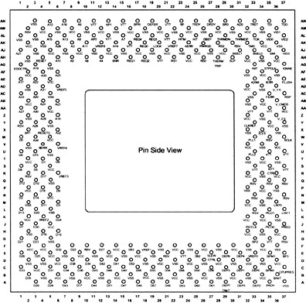
Figure 19–4 The pin-out of the socket 370 version of the Pentium III microprocessor. (Courtesy of Intel Corporation.)

Slide 66
19–4 PENTIUM 4 AND CORE2
Pentium 4 was released initially in November 2000 with a speed of 1.3 GHz.
  currently available in speeds up to 3.8 GHz
Two packages are available for early versions of this integrated microprocessor
  the 423-pin PGA and the 478-pin FC-PGA2
Both used 0.18 micron fabrication technology.
  0.13 micron or 90 nm technology now in use
Intel is currently developing a 45 nm technology for future products.

Slide 67
Newer versions of P4 use the LGA (leadless grid array) 775 package, which has 775 pins.
P4 uses a 100 MHz memory bus speed.
  because it is quad pumped, bus speed can approach 400 MHz
More recent versions use 133 MHz bus listed as 533 MHz, or 200 MHz listed as 800 MHz.
Figure 19–5 shows the pin-out of the 423-pin PGA of Pentium 4 microprocessor.

Slide 68
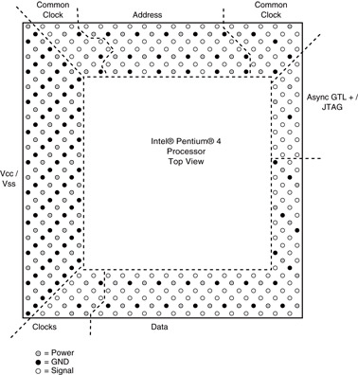
Figure 19–5 The pin-out of the Pentium 4, 423 PGA. (Courtesy of Intel Corporation.)
  some newer versions use a 1033 MHz or 1333 MHz front side bus
  another package called LGA 771 has appeared in newer versions
  of the Xeon

Slide 69
Memory Interface
The memory interface to Pentium 4 typically uses the Intel 945, 965, or 975 chip set.
  dual-pipe memory bus to the processor with each pipe interfaced to a 32-bit-wide memory section
The two pipes function together to comprise the 64-bit-wide data path to the processor.
Because of the dual-pipe arrangement, the memory must be populated with pairs of DDR2 memory devices operating at 600,
800, or 1033 MHz.

Slide 70
Intel has abandoned RDRAM in favor of DDR2 (double data rate) memory beginning with the 965 and 975 chip sets.
Newer chip sets such as the 945 and 965 contain the PCI Express interface.
  and do not contain the AGP interface
IDE support remains for interface to legacy devices such as older HDD, CD-ROM, and DVD drives.

Slide 71
Register Set
Nearly identical to all other versions except the MMX registers are separate entities from the floating-point registers.
Eight 128-bit-wide XMM registers are added for use with the SIMD (single-instruction, multiple data) instructions
  and extended 128-bit packed doubled floating-point numbers

Slide 72
Hyper-Threading Technology
The most recent innovation and new to Pentium is called hyper-threading technology.
  this significant advancement combines two microprocessors into a single package
Fig 19–6 shows a traditional dual processor system and a hyper-threaded system
The hyper-threaded processor contains two execution units.
  each with a complete set of the registers capable of running software independently or concurrently

Slide 73
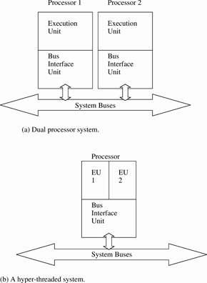
Figure 19–6 Systems illustrating dual processors and a hyper-threaded processor.
  the two separate machine contexts share a common bus interface unit
  each processor capable of running a thread (process) independently
  increases execution speed of applications written using multiple threads
  Processor must share memory or I/O access,
  with the bus interface unit

Slide 74
The bus interface unit contains the level 2
and level 3 caches
  and interface to memory and I/O structure
The BIU is in use to access memory in bursts to fill caches.
  since the BIU is often idle a second processor
  can use this idle time to access memory while
  the other processor is executing instructions
Some threads can run independently of each other as long as they do not access the same area of memory.

Slide 75
In most cases the system performance increases with hyper-threading.
  achieving nearly the same performance as
  a dual processor system
  the machine can actually run slower each thread accesses the same area of memory
Each thread runs on a different processor
in a system with dual or hyper-threaded processors.

Slide 76
Multiple Core Technology
New versions of Pentium 4 and Core2
contain dual or quad cores.
  each core is a separate version of the processor
  independently execute a separate tasks
Three versions are currently available:
  Pentium D, with two cores & separate caches
  Core2 Duo with a shared cache, but two cores
  a quad core version, which contains four cores
Core2 Duo contains either a 2M or 4M byte cache and operates at frequencies to 3 GHz.

Slide 77
CPUID
Table 19–7 lists the latest features available
to CPUID instruction.
These features are accessed using EAX.
  loaded with the input number listed in the table
CPUID usually returns information in EAX, EBX, ECX, & EDX in real or protected mode.
In Chapter 18 software was developed to read and display the data available after the CPUID instruction was invoked with EAX = 1.

Slide 78
Example 19–3 reads the processor brand string and prepare it for display in a Visual C++ function.
  if supported, the frequency the processor is certified to operate, and genuine Intel keyword
The BrandString function returns a CString with the information stored in CPUID members 80000002H–80000004H.
The Convert function reads EAX, EBX, ECX, and EDX from the register specified.
  and converts them to a CString that is returned

Slide 79
The author’s system brand string is
“Intel(R) Pentium(R) 4 CPU 3.06GHz”
Other information available about the system is returned in EAX, EBX, ECX, and EDX.
  after executing CPUID after loading EAX with a 1
EAX contains the model, family, and stepping information, as illustrated in Figure 19–7.
EBX contains information such as the size of the cache line flushed by the CFLUSH in bits 15–8 and the ID assigned the local APIC on reset in bits 31–24.

Slide 80
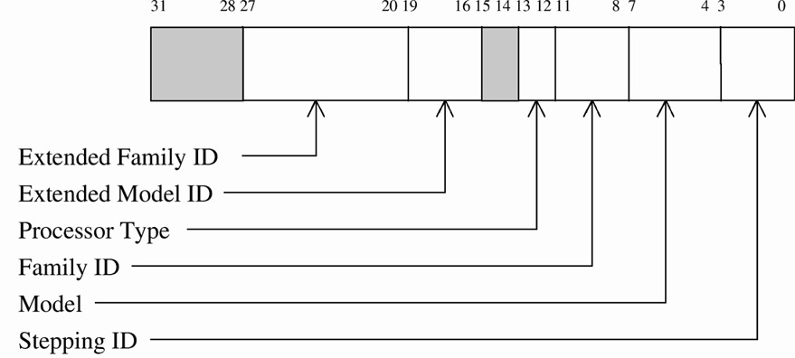
Figure 19–7 EAX after a CPUID instruction showing version information.
  Bits 23–16 indicate how many internal processors are available to hyper-threading
  two for the current Pentium 4 microprocessor

Slide 81
Feature information for the processor is returned in ECX & EDX.
  each bit is logic 1 if the feature is present
BT tests the bit indicated and places it in
the carry flag.
If the tested bit is a 1: resultant carry is one.
if the tested bit is a 0, resultant carry is zero.
See Figures 19–8 and 19–9.

Slide 82
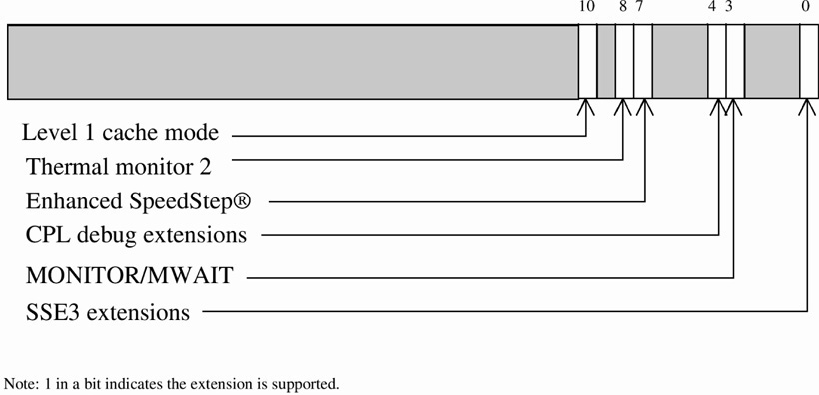
Figure 19–8 ECX after a CPUID instruction showing the version extensions.

Slide 83
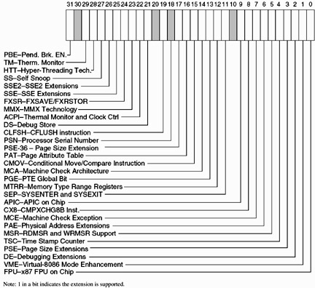
Figure 19–9 EDX after a CPUID instruction showing the version extensions.

Slide 84
Model-Specific Registers
Pentium 4 and Core2 contain model-specific registers read with the RDMSR and written with WRMSR.
Each have 1743 model-specific registers numbered from 0H to 6CFH.
  Intel does not provide information on all of them
Registers not identified are reserved by Intel.
  or used for undocumented features or functions

Slide 85
Both read and write model-specific register instructions function in the same manner.
ECX is loaded with the register number.
Data are transferred through the EDX:EAX register pair as a 64-bit number.
  EDX is most significant 32 bits
  EAX is the least significant bits
These registers must be accessed in either real mode (DOS) or ring 0 of protected mode.
Normally accessed by the OS and cannot be accessed in normal Visual C++ programming.

Slide 86
Performance-Monitoring Registers
Like the model-specific registers, only used
in real mode or at ring 0 of protected mode.
The only PMR that can be accessed via
user software is the time-stamp counter.
Remaining PMRs are accessed with RDPMR.
  similar to the RDMSR instruction
ECX specifies the register number and the result appears in EDX:EAX.
There is no write instruction for the PMRs.

Slide 87
64-Bit Extension Technology
The instruction set and architecture is backwards compatible to the 8086.
  the instructions and register set remain compatible
Not compatible are a few legacy instructions and some dealing with AH, BH, CH, and DH.
The register set is 64 bits in width
Refer to Figure 19–10 for the programming model of Pentium 4 and Core2 in 64-bit mode.

Slide 88
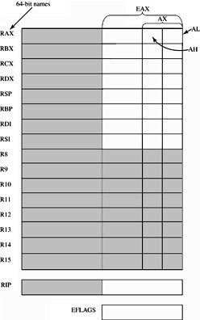
Figure 19–10 The integer register set in the 64-bit mode of the Pentium 4. The shaded areas are new to the Pentium 4 operated in the 64-bit mode.
  the register set now contains sixteen 64-bit-wide general-purpose registers
  RAX, RBX, RCX, RDX, RSP, RBP, RDI, RSI, R₈–R₁₅
  64 bit instruction pointer allows
  a 64-bit memory address
  this allows the processor to address as much memory as
  the specific implementation
  of the microprocessor has address pins

Slide 89
The registers are addressed as 64-bit, 32-bit, 16-bit, or 8-bit registers.
  an example is R8 (64 bits), R8D (32 bits), R8W (16 bits), and R8L (8 bits)
There is no way to address the high byte (as in BH) for a numbered register.
  only the low byte can be addressed
Legacy addressing functions correctly, but addressing a legacy high-byte register and
a numbered low-byte register is not allowed
  MOV AH,R9L isn’t allowed; MOV AL,R9L is OK

Slide 90
Additional SSE registers XMM₈–XMM₁₅ are accessed by SSE, SSE₂, or SSE₃ .
  otherwise theSSE unit has not been changed
Control & debug registers are 64 bits in width.
A new model-specific register is added to control the extended features at address C0000080H.
Figure 19–11 depicts the extended feature control register.

Slide 91

Figure 19–11 The contents of the extended feature model-specific register.
  SCE - The system CALL enable bit is set to enable SYSCALL and SYSRET in 64-bit mode
  LME - The mode enable bit is set to allow the microprocessor to use 64-bit extended mode
  LMA - The mode active bit shows the processor is operating in the 64-bit extended mode.

Slide 92
Protected mode descriptor table registers
are expanded in the extended 64-bit mode.
Each descriptor table register, GDTR, LDTR, IDTR, and the task register (TR) hold a 64-bit base address.
  instead of a 32-bit base address
Paging is modified to include translation of a 64-bit linear into a 52-bit physical address.

Slide 93
Intel states that in the first version of this 64-bit Pentium the linear address will be 48 bits and the physical address will be 40 bits.
This means there will be a 40-bit address to support 1T (terra) byte of physical memory.
  translated from 256T bytes linear address space
The 52-bit address accesses 4P (peta) bytes.
  64-bit linear address accesses 16E (exa) bytes
In place of two tables (a page directory and a page table), the 64-bit extended paging unit uses four levels of page tables.

Slide 94
SUMMARY
The Pentium II differs from earlier microprocessors because instead of being offered as an integrated circuit, the Pentium II is available on a plug-in cartridge or printed circuit board.
The level 2 cache for the Pentium II is mounted inside of the cartridge, except for the Celeron, which has no level 2 cache.

Slide 95
SUMMARY
(cont.)
The cache speed is one half the Pentium II clock speed, except in the Xeon, where it is at the same speed as the Pentium II.
All versions of the Pentium II contain an internal level 1 cache that stores 32K bytes of data.
The Pentium II is the first Intel processor that is controlled from an external bus controller.

Slide 96
SUMMARY
(cont.)
Unlike earlier versions which issued read and write signals, the Pentium II is ordered to read or write information by an external bus controller.
The Pentium II operates at clock frequencies from 233 MHz to 450 MHz
with bus speeds of 66 MHz or 100 MHz.
The level 2 cache can be 512K, 1M, or 2M bytes in size.

Slide 97
SUMMARY
(cont.)
The Pentium II contains a 64-bit data bus and a 36-bit address bus that allow up to 64G bytes of memory to be accessed.
The new instructions added to the Pentium II are SYSENTER, SYSEXIT, FXSAVE, and FXRSTOR.
The SYSENTER and SYSEXIT commands are optimized to access the operating system in privilege level 0 from a privilege level 3 access.

Slide 98
SUMMARY
(cont.)
These instructions operate at a much higher speed than a task switch or even a call and return combination.
The FXSAVE and FXRSTOR instructions are optimized to store the state of the MMX unit and floating-point coprocessor.
The Pentium III microprocessor is an extension of the Pentium Pro architecture with the addition of the SIMD instruction set that uses the XMM registers.

Slide 99
SUMMARY
(cont.)
The Pentium 4 and Core2 microprocessors are extensions of the Pentium Pro architecture, which includes enhancements that allow it to operate at higher clock frequencies than previously possible because of the 0.13 micron and the
latest 45 nm fabrication technologies.
The Pentium 4 and Core2 microprocessors require a modified ATX power supply and case to function properly in a system.

Slide 100
SUMMARY
(cont.)
Version 6.15 of the MASM program and Visual Studio version 6 now support the new MMX and SIMD instructions using
the .686 switch with the .MMX and .XMM switches.
The Pentium II, Pentium III, Pentium 4, and Core2 microprocessors are all variations of the Pentium Pro microprocessor.

Slide 101
SUMMARY
Future Pentium 4 and Core2 microprocessors will all use the 64-bit extension to the 32-bit architecture.
This will become important in systems
with more than 4G bytes of memory.

